Slide 1

High Strength Waste Project Muscatine Water Pollution Control Plant Resource Recovery Facility
City of Muscatine Council
Jay Brady, P.E., Stanley Consultants
Jon Koch, City of Muscatine
January 12, 2017

Slide 2
Muscatine
Area
Resource
Recovery for
Vehicles &
Energy
MARRVE puts Muscatine on the path to sustainability

Slide 3

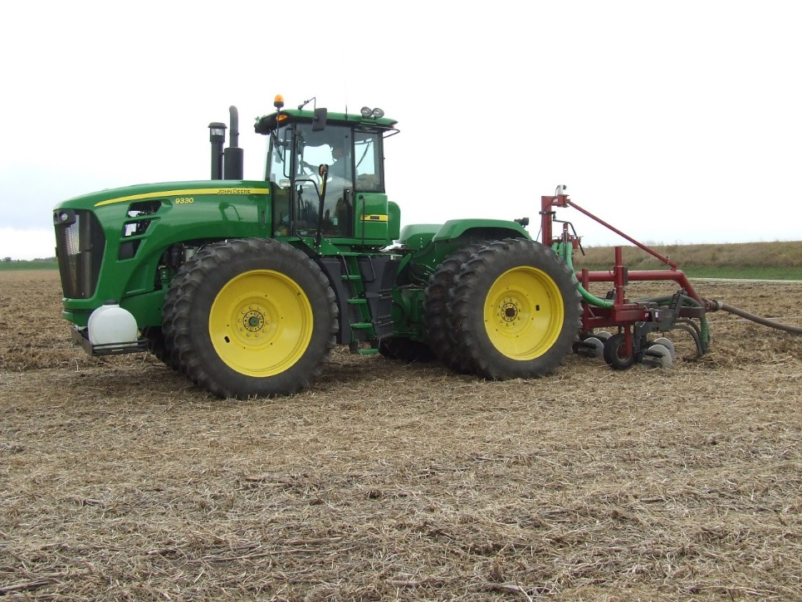


Slide 4




Slide 5
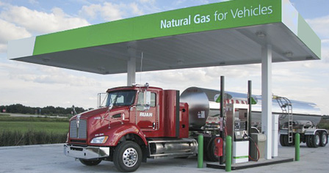
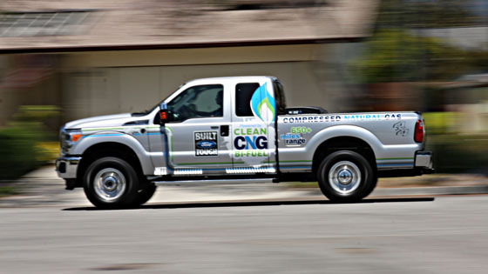

Slide 6
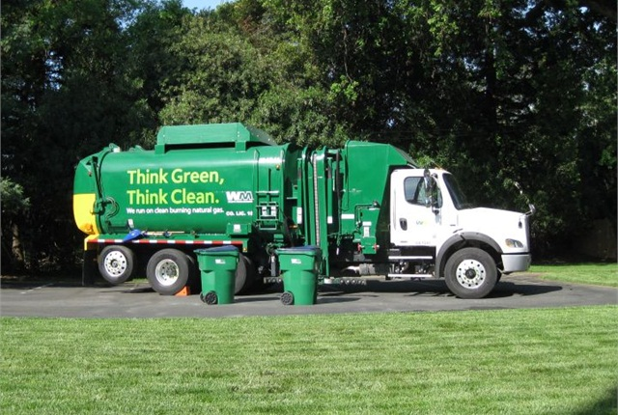
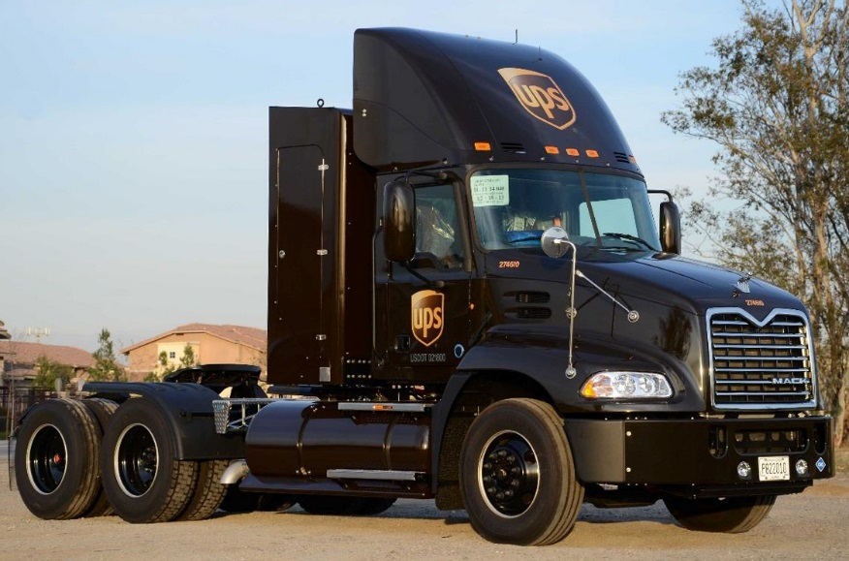
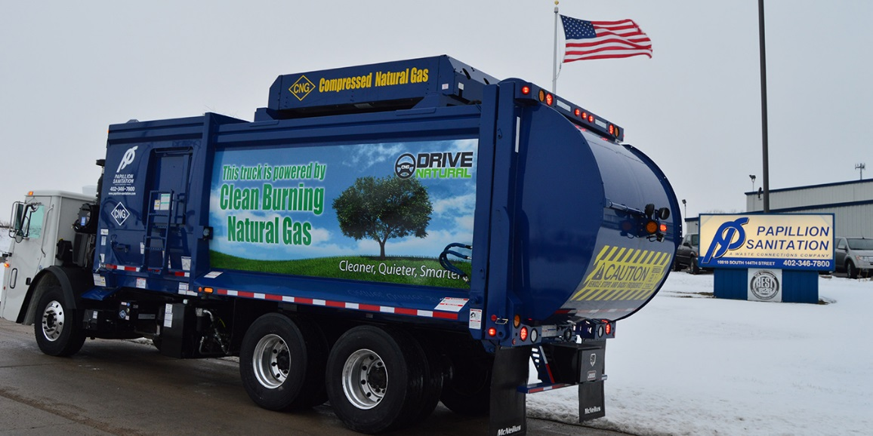

Slide 7
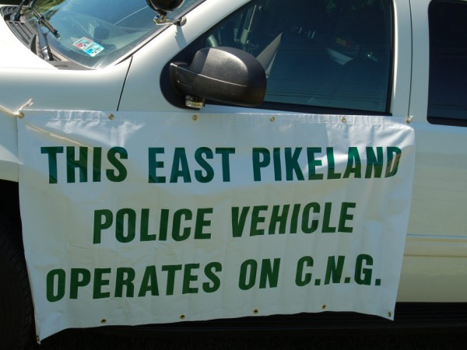
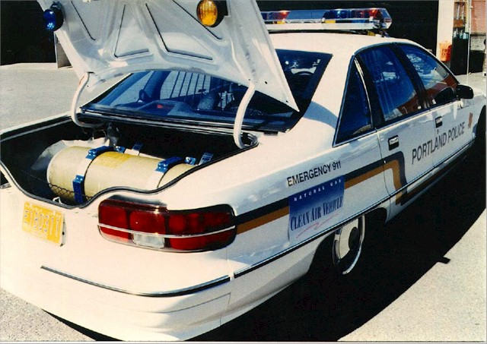
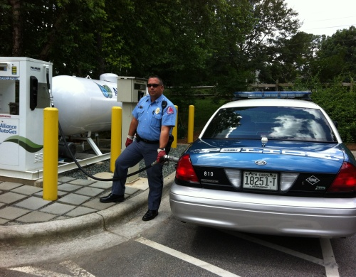
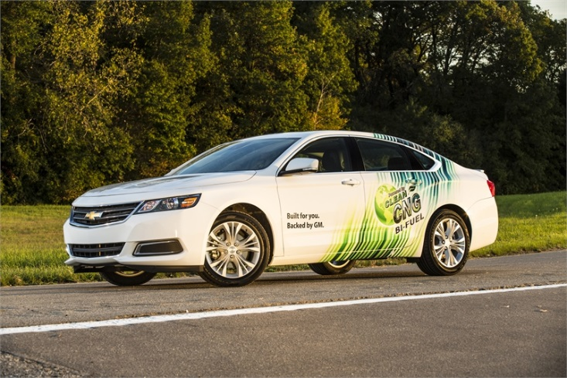

Slide 8
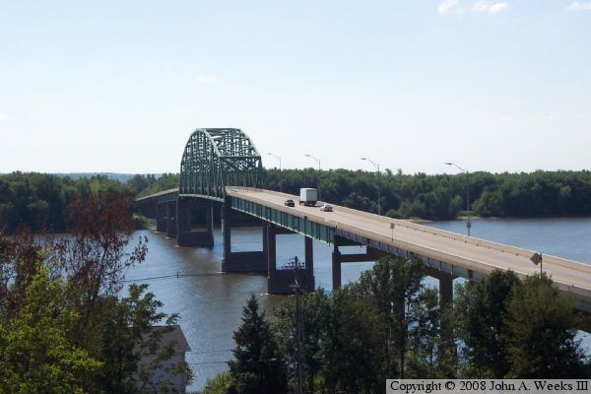


Slide 9
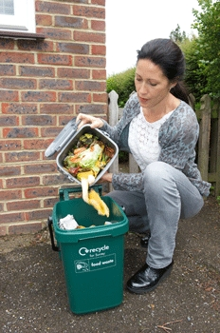
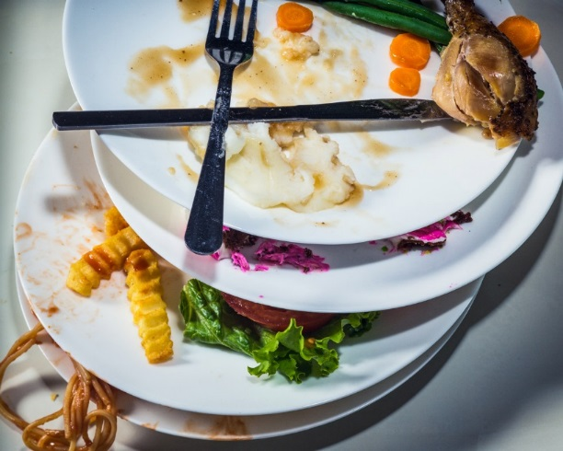
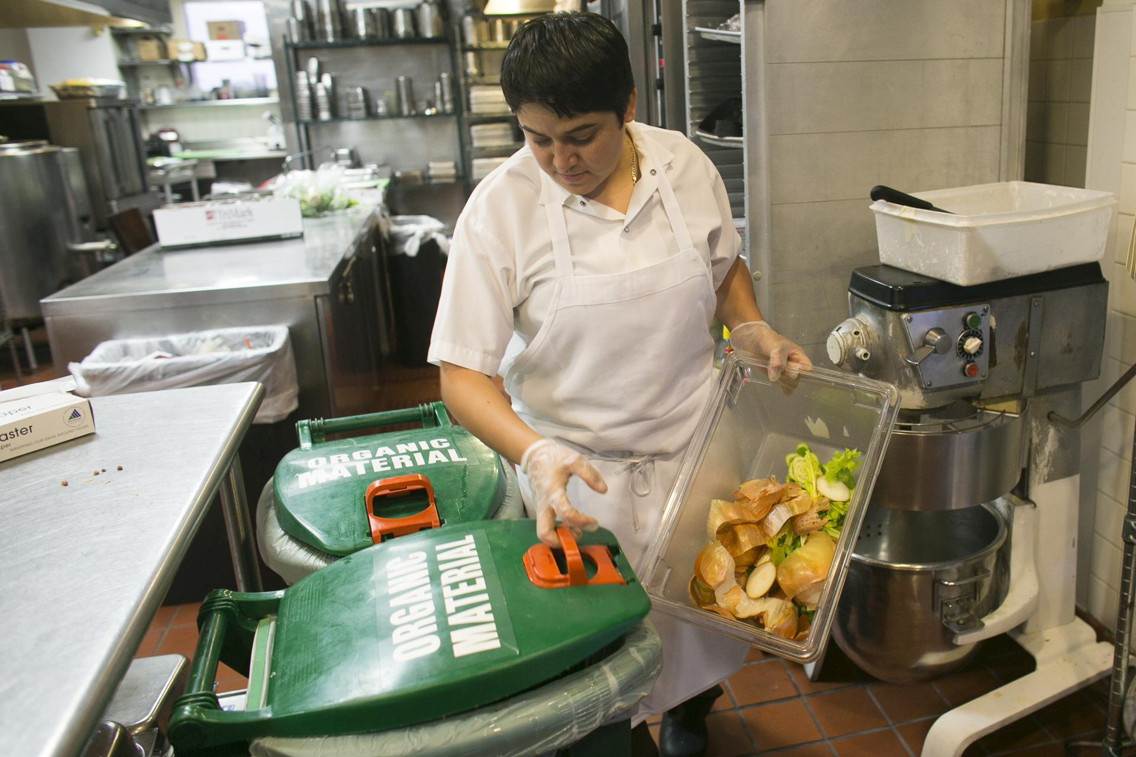
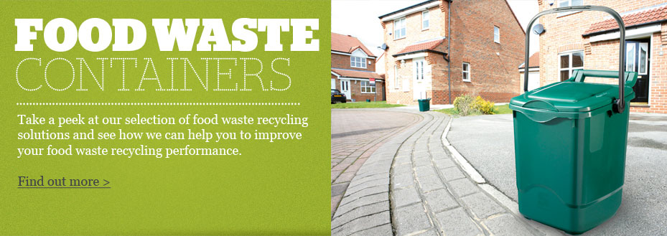

Slide 10

Organics Recovery Is Possible!
40% of food produced is not eaten
20% of landfill waste is organic and can be recycled
Resource Recovery Is Needed!
Revenue and Clean Renewable Energy from Waste

Slide 11
Idea Formulation
Local Organic Wastes + Anaerobic Digestion= RENEWABLE FUEL FOR VEHICLES
FOG Program + Spare Unused Tanks + Lightly Loaded Digesters + Continuously flaring unused Digester Gas = OPPORTUNITY

Slide 12
Waste to Fuel Benefits
Landfill diversion (up to 20%) saving expensive landfill space
Lower air emissions
Provides a needed service to the community/industry (good for industry and the environment)
Long term potential for recouping capital and developing a sustainable revenue source for wastewater

Slide 13
Waste Types (Feedstocks)
FOG = Fats, Oils, Greases – Restaurants
Liquid Organic Waste = high strength waste – liquid wastes with high organic content – often from food processors
Solid Organic Waste
packaged materials – ex. bottled ketchup
past prime vegetables from grocer
cafeteria waste from schools

Slide 14
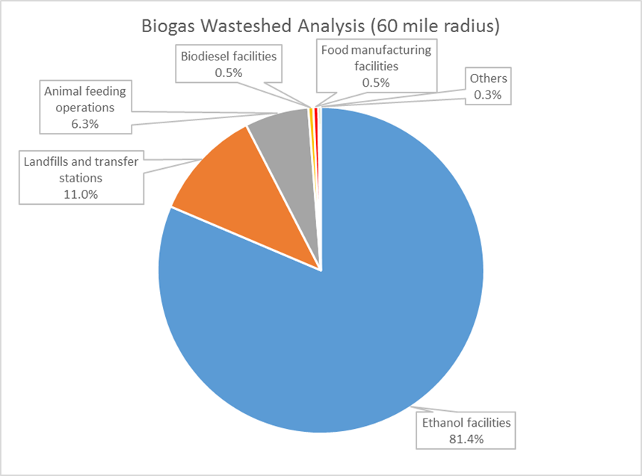
Local Potential
230 million CF Biogas/day
990,000 Diesel Gallons/Day
Source: EcoEngineers

Slide 15
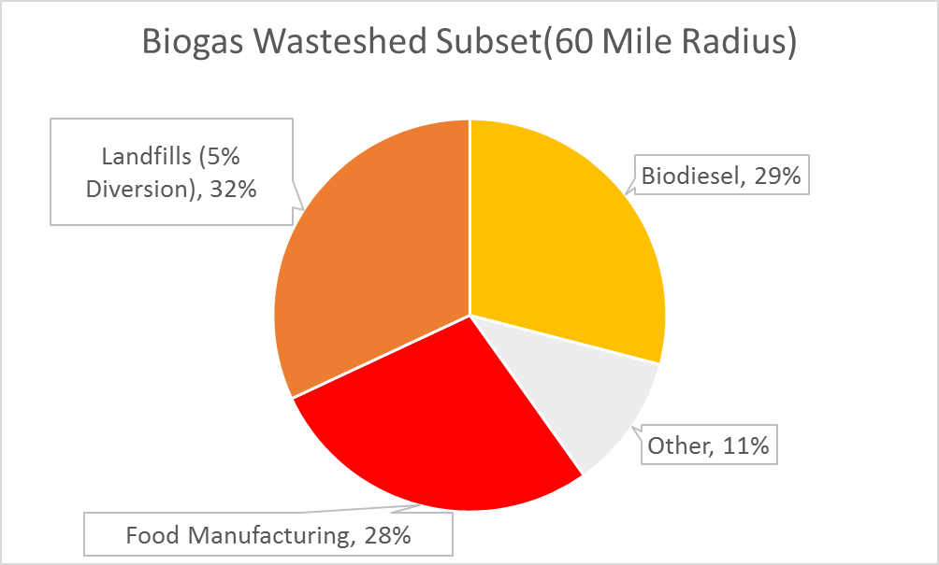
Local Potential
4 million CF Biogas/day
17,000 Diesel Gallons/Day
Source: EcoEngineers, Stanley Consultants

Slide 16
Local Potential
FOG Haulers
Local Industries such as Heinz
Local Businesses such as HyVee
Regional Industries
Possible Fuel Purchase Partner (Ruan)

Slide 17
Local Potential
Feedstock Source | gpd
Treatment Sludge | 36,778
Organic Solid Waste | 2,646
Organic Liquid Waste | 1,500
FOG/Available | 21,670
Existing Digestion Capacity | 62,594

Slide 18
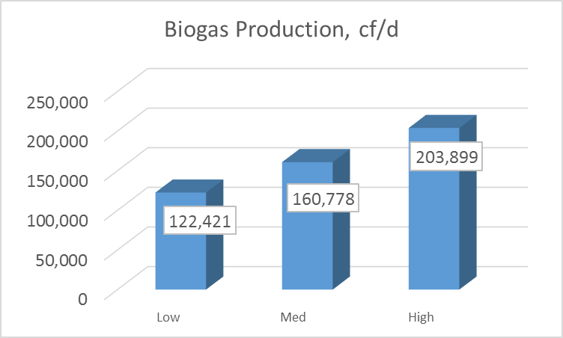
Biogas Production

Slide 19
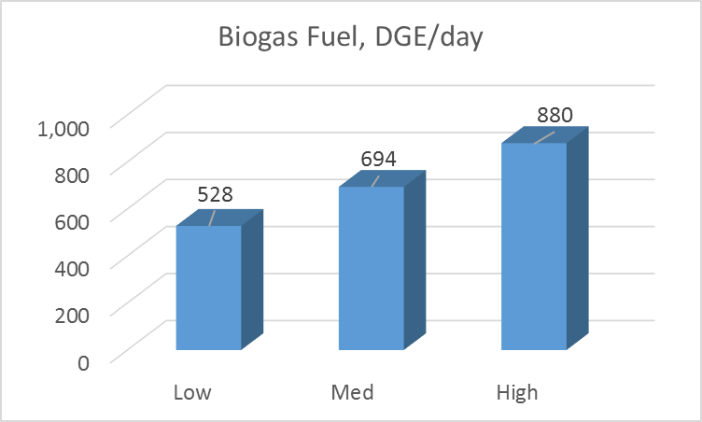
Biogas Fuel in Diesel Gallons

Slide 20
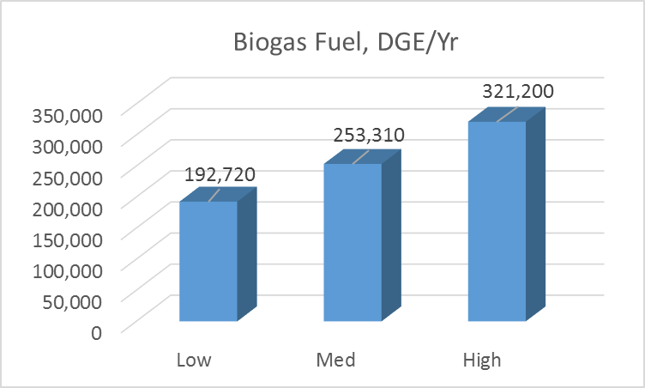
Biogas Fuel in Diesel Gallons

Slide 21
The Overall Long-Term Project
Receiving Facility – Phase 1
Feeding Facility – Phase 1
Digestion
Biogas Treatment Facilities
Biogas Usage Facilities

Slide 22
The Project
Receiving Facility
Receive & Preliminary Treat:
FOG – remove rocks, cutlery, debris
Organic Liquid Waste - remove debris
Organic Solid Waste – depackage and grind, recover package materials

Slide 23
The Project
Feeding Facility
Two heated tanks for equalization and controlled feed to digesters

Slide 24
Project - Location

Slide 25
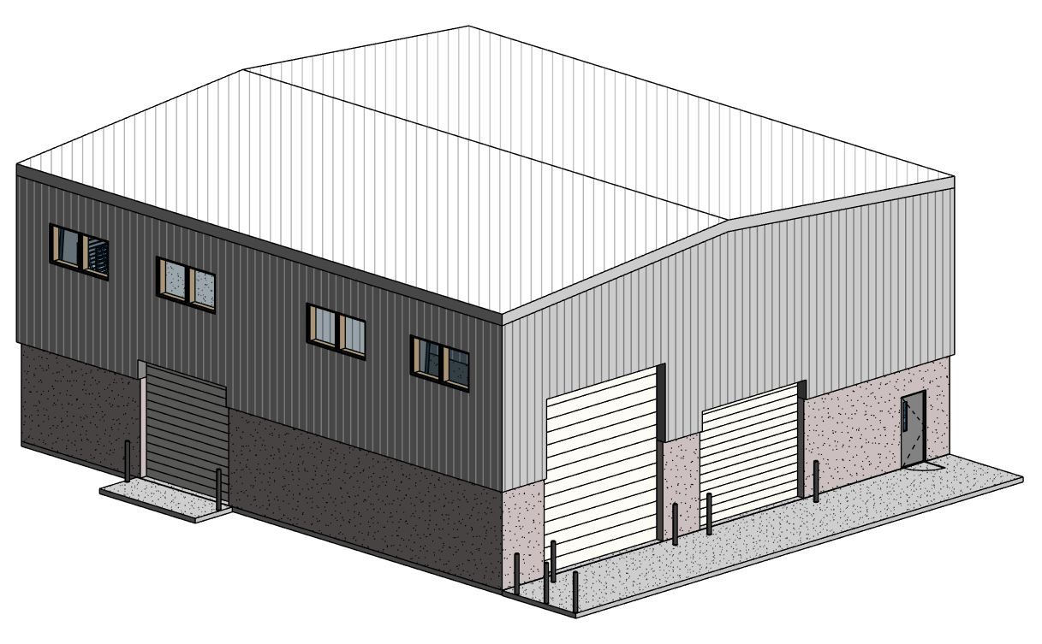
The Project – Receiving Building
Building Concepts

Slide 26
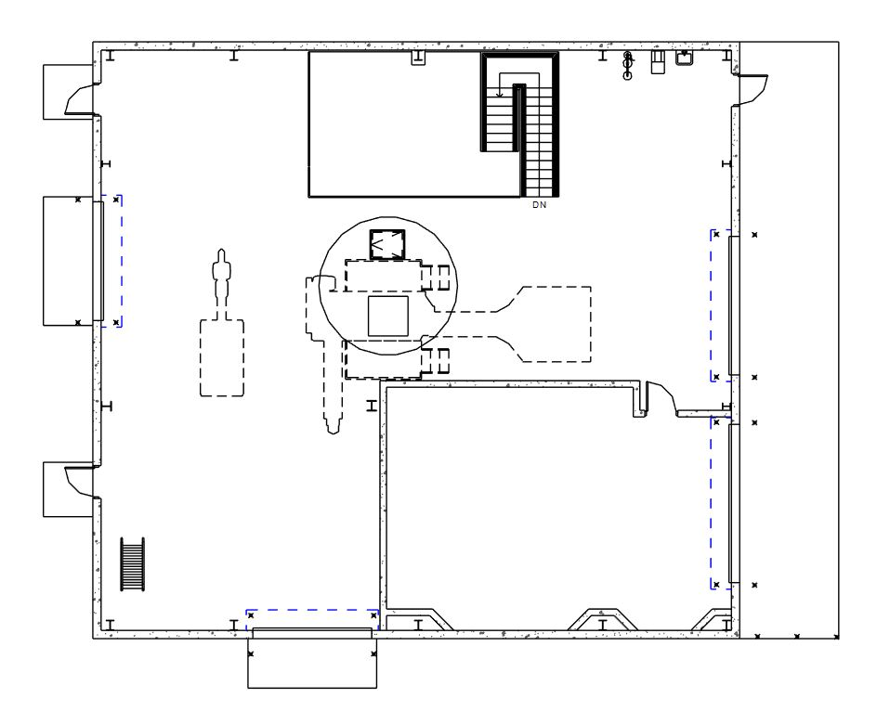
The Project – Receiving Building
Building Concepts
Pumping
Turbo Separator
Liquid Waste
Receiving
Tipping Floor

Slide 27
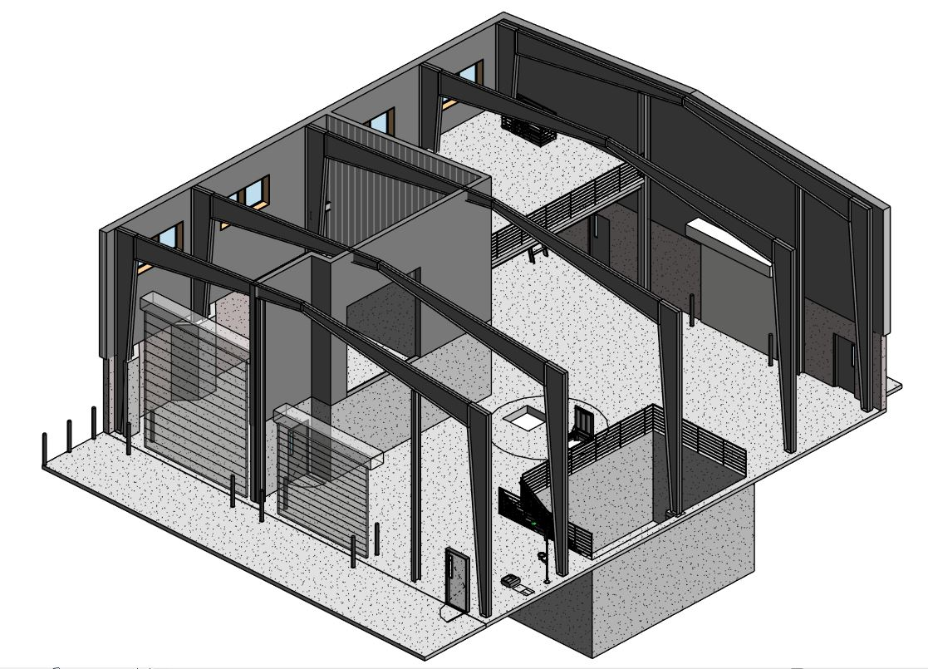
The Project – Receiving Building
Building Concepts

Slide 28
Estimated Project Cost
Phase 1 Receiving/Feed Facilities
$2.5 to $3 million
Includes Organic Solid Waste Separation and Odor Control ~$0.5 million
Phase 2 Gas Treatment and BioCNG Vehicle Fueling Facility
$2.5 to $3 million
Fill rates, configuration, and CNG storage capacity alter cost

Slide 29
Projected Operational Costs
Phase 1

Slide 30
Potential Revenues
Potential Revenue Sources
Waste tipping fees
Fuel Value
Renewable Energy Credits
Petroleum Producer $ paid to obtain offsetting renewable energy credits
Federal credits + for transportation related credits states such as CA, OR
Can be substantial revenue stream that can offset the capital investment

Slide 31
Potential Revenues
Potential Revenue Sources
Tipping Fees ~ $60,000 per year since 2012

Slide 32
Rate of Return Analysis
Potential Revenue Sources
Tipping Fees ~ $60,000 per year since 2012

Slide 33
Risks
Lower organic waste volumes
Lower fuel usage/sales
Lower tipping fee rates
Lower RIN values or phase out
Higher operating costs

Slide 34
Timeline
Phase 1
Design Completion February 2017
Phase Permitting/Bidding March/April 2017
Construction May – Dec 2017
Commissioning/Start Up Jan/Feb 2018
Phase 2
Design 2017
Construction 2018

Slide 35
Discussion

Slide 36
Some Waste to Fuel Basics
1 gallon of digested food waste produces 20 cubic feet (CF) of digester gas
1 gallon of digested FOG produces 2 CF of digester gas (due to water)
1000 CF of digester gas = 0.6 mmbtu
In terms of vehicle fuel
1000 CF of digester gas = 4 gallons of diesel fuel or 5 gallons of gasoline
= 150 miles car or 20 miles semi-truck

Slide 37
Some Waste to Fuel Basics
1 Ton (~200 gallons) of food waste yields ~17 gallons of diesel

